Slide 1


INTRODUCTION TO FINANCE
PROJECT NAME :
GROUP MEMBERS:
Capital Asset Pricing Model
Piyush Arora
Kartik Choudhary
Vasubhya Diwan
Nishtha Karki

Slide 2


DELIVERABLES
 | Choose a risk-free asset and select 10 risky assets from the market. Calculate the expected return for each risky asset using CAPM formula and derive the Capital Market Line (CML) equation. Calculate individual Security Market Lines (SMLs). Compute performance measures like Sharpe Ratio and Treynor Ratio for optimized portfolios and Comparethem to individual assets for evaluation.

Slide 3

ASSETS
RISKY-
APPLE
ADANI POWER
AMD
FORD MOTORS
INTEL
META
MICROSOFT
QUALCOMM
RELIANCE
TESLA
NON RISKY-
CBOE Interest Rate 10 Year T No
MARKET- SP500

Slide 4



EFFICIENT FRONTIER
We began by constructing the Efficient Frontier, which illustrates the optimal portfolios that offer the highest expected return for a given level of risk. The x-axis represents risk (standard deviation), and the y-axis represents return. Each point on the frontier represents a portfolio with a unique combination of risky assets.
where:
w is the weight vector of assets in the portfolio.
Σ is the covariance matrix of the assets.

Slide 5

TANGENCY PORTFOLIO
We calculated the weights for the Tangency PortfolioThese weights, aimed at maximizing returns while managing risk, are determined by optimizing the Sharpe Ratio. The formula takes into account the covariance matrix, average returns, and the risk-free rate, resulting in an allocation of assets that offers the best risk-adjusted performance.
where:
w tangent:Weight vector for the Tangency Portfolio.
Σ: Covariance matrix of the risky assets.
R: Vector of average returns for the risky assets.
Rf: Risk-free rate.
1: Vector of ones.

Slide 6

CAPITAL MARKET LINE
The Capital Market Line (CML) represents the relationship between risk and return for efficient portfolios that combine the risk-free asset with a risky portfolio. In our analysis, we used the CML to find the optimal portfolio where the Efficient Frontier is tangent to the CML, representing the best risk-return tradeoff.
where:
CML is the Capital Market Line.
Rf :is the risk-free rate.
Return tangent : is the return of the Tangency Portfolio.
σ tangent : is the standard deviation (risk) of the Tangency Portfolio.
σ is the standard deviation (risk) of the portfolio.

Slide 7
SECURITY MARKET LINE
The Capital Market Line (CML) represents the relationship between risk and return for efficient portfolios that combine the risk-free asset with a risky portfolio. In our analysis, we used the CML to find the optimal portfolio where the Efficient Frontier is tangent to the CML, representing the best risk-return tradeoff.
where:
CML is the Capital Market Line.
Rf :is the risk-free rate.
Return tangent : is the return of the Tangency Portfolio.
σ tangent : is the standard deviation (risk) of the Tangency Portfolio.
σ is the standard deviation (risk) of the portfolio.

Slide 8
SECURITY MARKET LINE
RELATIONSHIP TO MARKET RISK: THE SLOPE OF THE SML REPRESENTS THE MARKET RISK PREMIUM, WHICH IS THE EXCESS RETURN EXPECTED FROM AN INVESTMENT IN THE STOCK MARKET OVER THE RISK-FREE RATE. STOCKS WITH HIGHER BETAS (ABOVE 1) WILL HAVE STEEPER SLOPES ON THE SML, INDICATING HIGHER EXPECTED RETURNS BECAUSE THEY ARE MORE SENSITIVE TO MARKET MOVEMENTS.
COMPARISON TO RISK-FREE RATE: IF THE SLOPE IS POSITIVE, IT MEANS THAT THE EXPECTED RETURN ON THE STOCK IS GREATER THAN THE RISK-FREE RATE, WHICH IMPLIES THAT THE STOCK PROVIDES COMPENSATION FOR THE ADDITIONAL RISK ASSOCIATED WITH INVESTING IN THE MARKET.

Slide 9
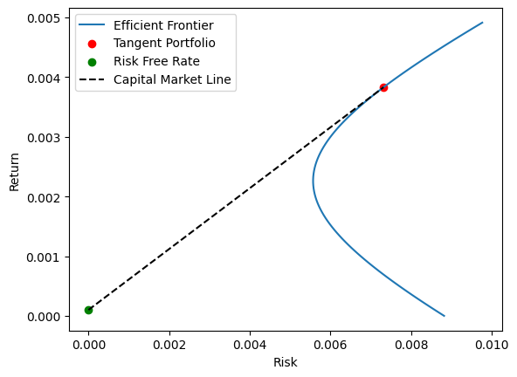

Slide 10
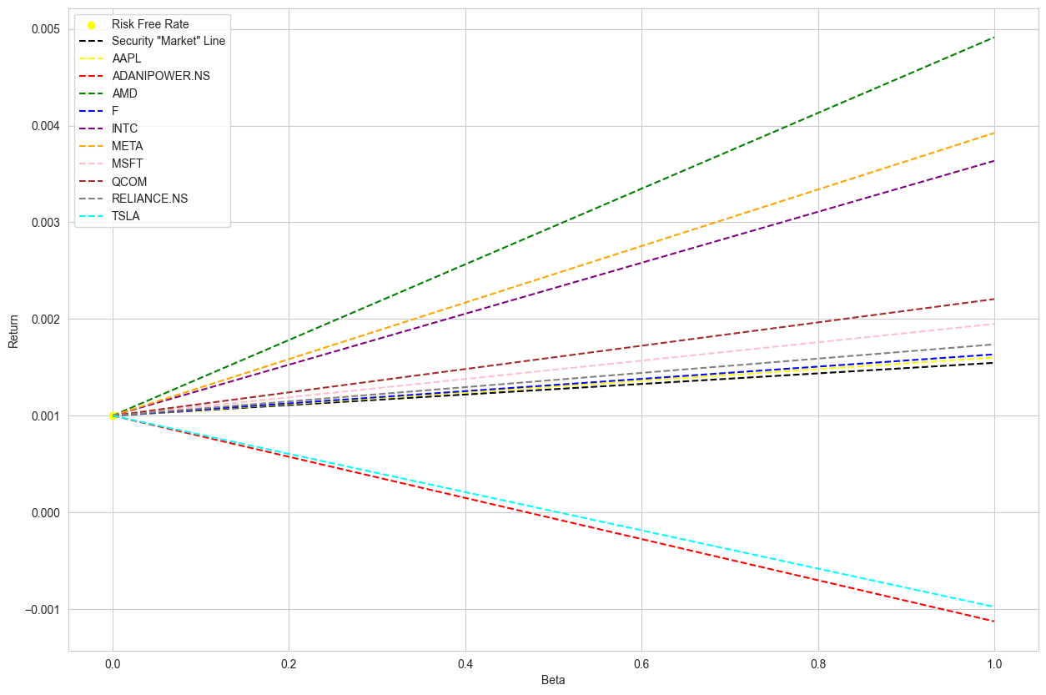

Slide 11
PERFORMANCE MEASURES FOR OPTIMIZED PORTFOLIOS

Slide 12

SHARPE RATIO
Higher Sharpe Ratio implies better risk-adjusted return.
Comparing Sharpe Ratios of individual assets to the optimized portfolios helps us to assess if the portfolios offer superior risk-adjusted returns.
Portfolios with higher Sharpe Ratios are preferred as they generate more return per unit of risk taken.
Rp :Portfolio return.
Rf : Risk-free rate.
σp: Portfolio standard deviation (risk).

Slide 13

TREYNOR RATIO
Higher Treynor Ratio indicates better risk-adjusted performance relative to systematic risk.
It helps in evaluating how well a portfolio compensates investors for bearing systematic risk.
Comparing Treynor Ratios allows us to assess if the optimized portfolios provide excess return relative to their systematic risk.
Rp :Portfolio return.
Rf : Risk-free rate.
βp: Portfolio beta, a measure of systematic risk.

Slide 14

RESULTS
PORTFOLIO 1 - SHARPE RATIO: 0.400621819582343
PORTFOLIO 2 - SHARPE RATIO: 0.400621819582343
AAPL - Sharpe Ratio: 0.012981986434434455
ADANIPOWER.NS - Sharpe Ratio: 0.003216858329258295
AMD - Sharpe Ratio: -0.013536541168983108
F - Sharpe Ratio: 0.013072035516164435
INTC - Sharpe Ratio: -0.0010017027745127353
META - Sharpe Ratio: 0.000565040438834808
MSFT - Sharpe Ratio: 0.010256619319375085
QCOM - Sharpe Ratio: 0.010639963396855459
RELIANCE.NS - Sharpe Ratio: 0.01970838422150309
TSLA - Sharpe Ratio: 0.04457798357252183

Slide 15
RESULTS
PORTFOLIO 1 - TREYNOR RATIO: -0.0077741919986532735
PORTFOLIO 2 - TREYNOR RATIO: -0.00777419199865327
AAPL - Treynor Ratio: 0.0005466758920680525
ADANIPOWER.NS-Treynor Ratio: 0.0005466758920680522
AMD - Treynor Ratio: 0.0005466758920680526
F - Treynor Ratio: 0.0005466758920680527
INTC - Treynor Ratio: 0.0005466758920680527
META - Treynor Ratio: 0.0005466758920680596
MSFT - Treynor Ratio: 0.0005466758920680526
QCOM - Treynor Ratio: 0.0005466758920680532
RELIANCE.NS - Treynor Ratio: 0.0005466758920680529
TSLA - Treynor Ratio: 0.000546675892068052

Slide 16
KEY INSIGHTS
Markowitz Approach:
Diversification
Efficient Frontier
Individual Asset Consideration
Optimal Portfolio Selection
Risk Management
CAPM Approach:
Systematic Risk
Tangency Portfolio
Sharpe Ratio Optimization
Market Portfolio Connection
Market Sensitivity

Slide 17
COMPARISON AND CONTRAST
Approach:
Markowitz: Emphasizes diversification across assets.
CAPM: Focuses on balancing systematic risk and return relative to the market.
Optimization:
Markowitz: Maximizes returns for a given level of risk or minimizes risk for a given level of return.
CAPM: Seeks the optimal portfolio by maximizing the Sharpe Ratio, considering the risk-free rate and market return.
Portfolio Selection:
Markowitz: Offers a range of portfolios along the Efficient Frontier.
CAPM: Identifies the Tangency Portfolio as the optimal point on the Efficient Frontier.
Risk Consideration:
Markowitz: Considers individual asset risks and correlations.
CAPM: Focuses on systematic risk measured by beta.

